Slide 1
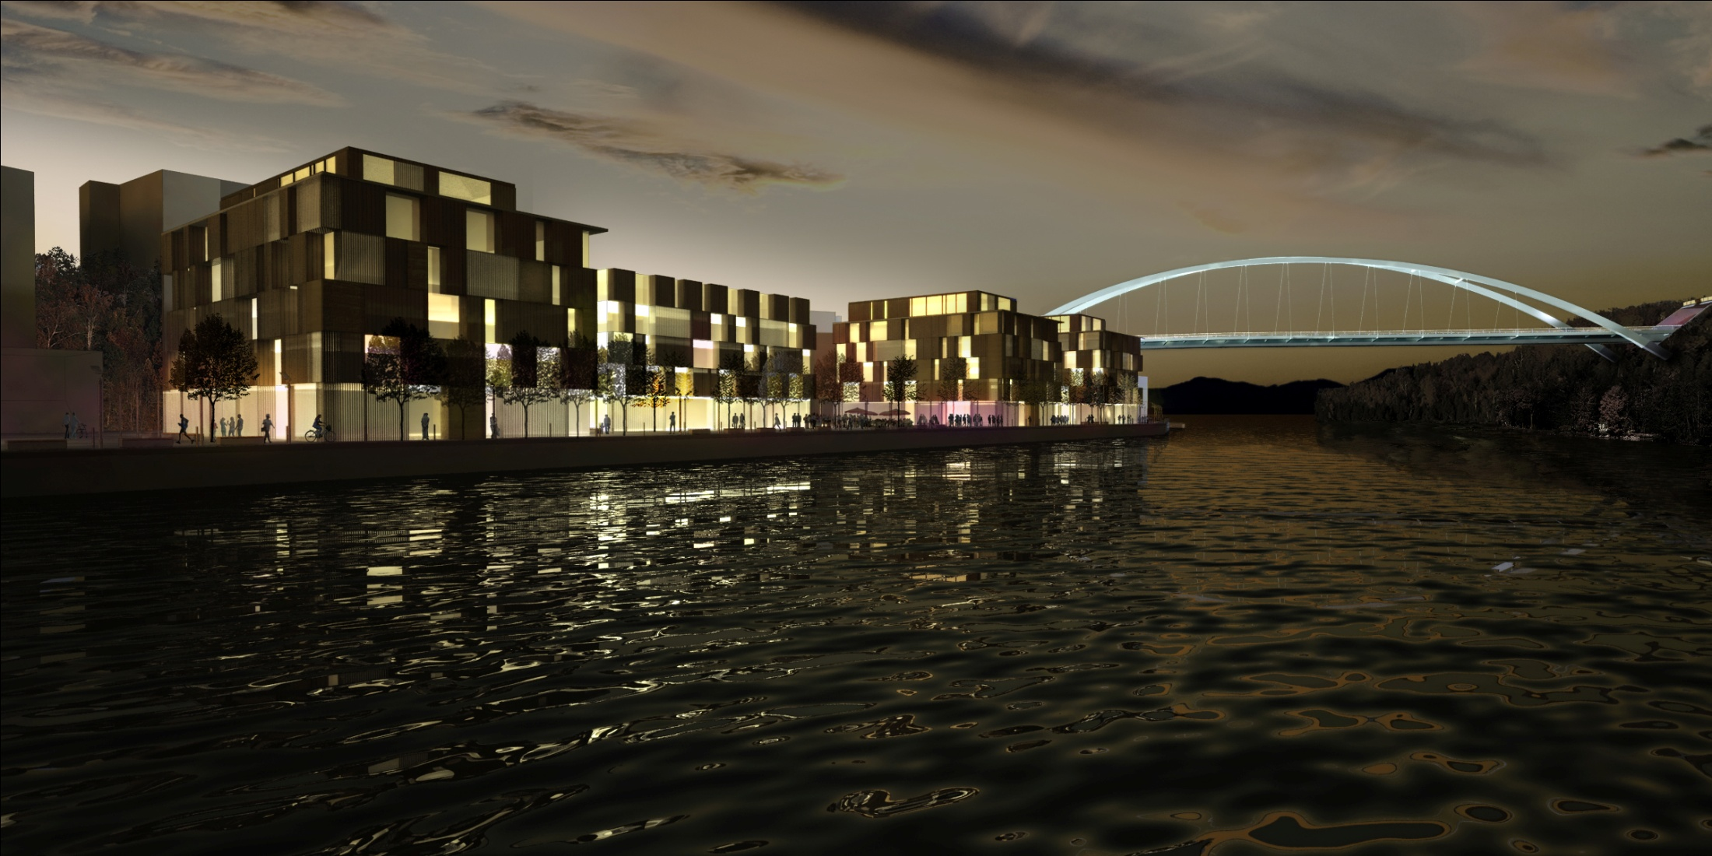
The first public transportation project procured through Competitive Dialogue in Sweden
C

Slide 2
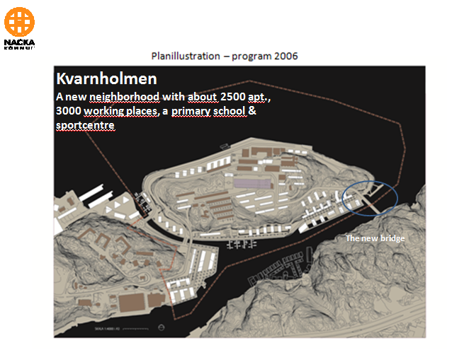

Slide 3
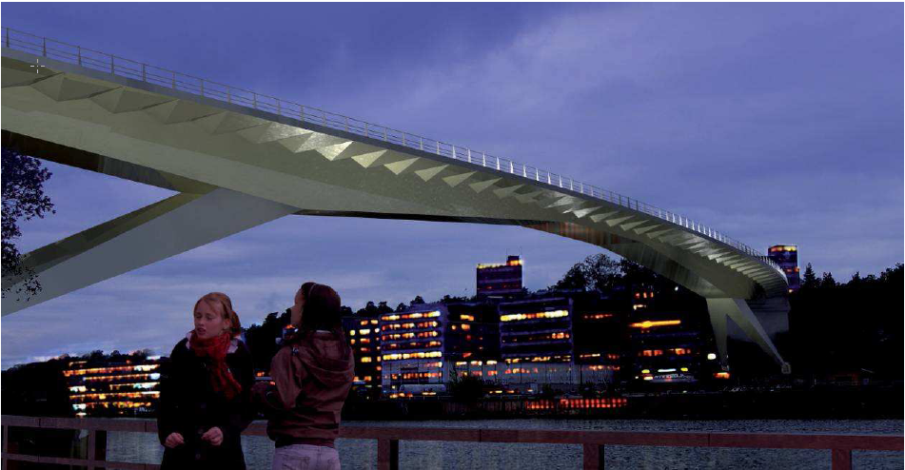
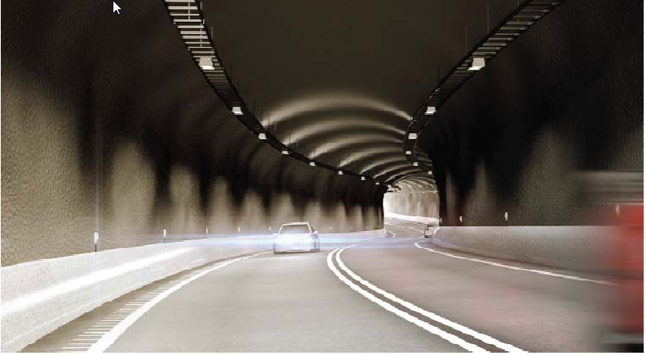
Nackas own entrance proposal

Slide 4
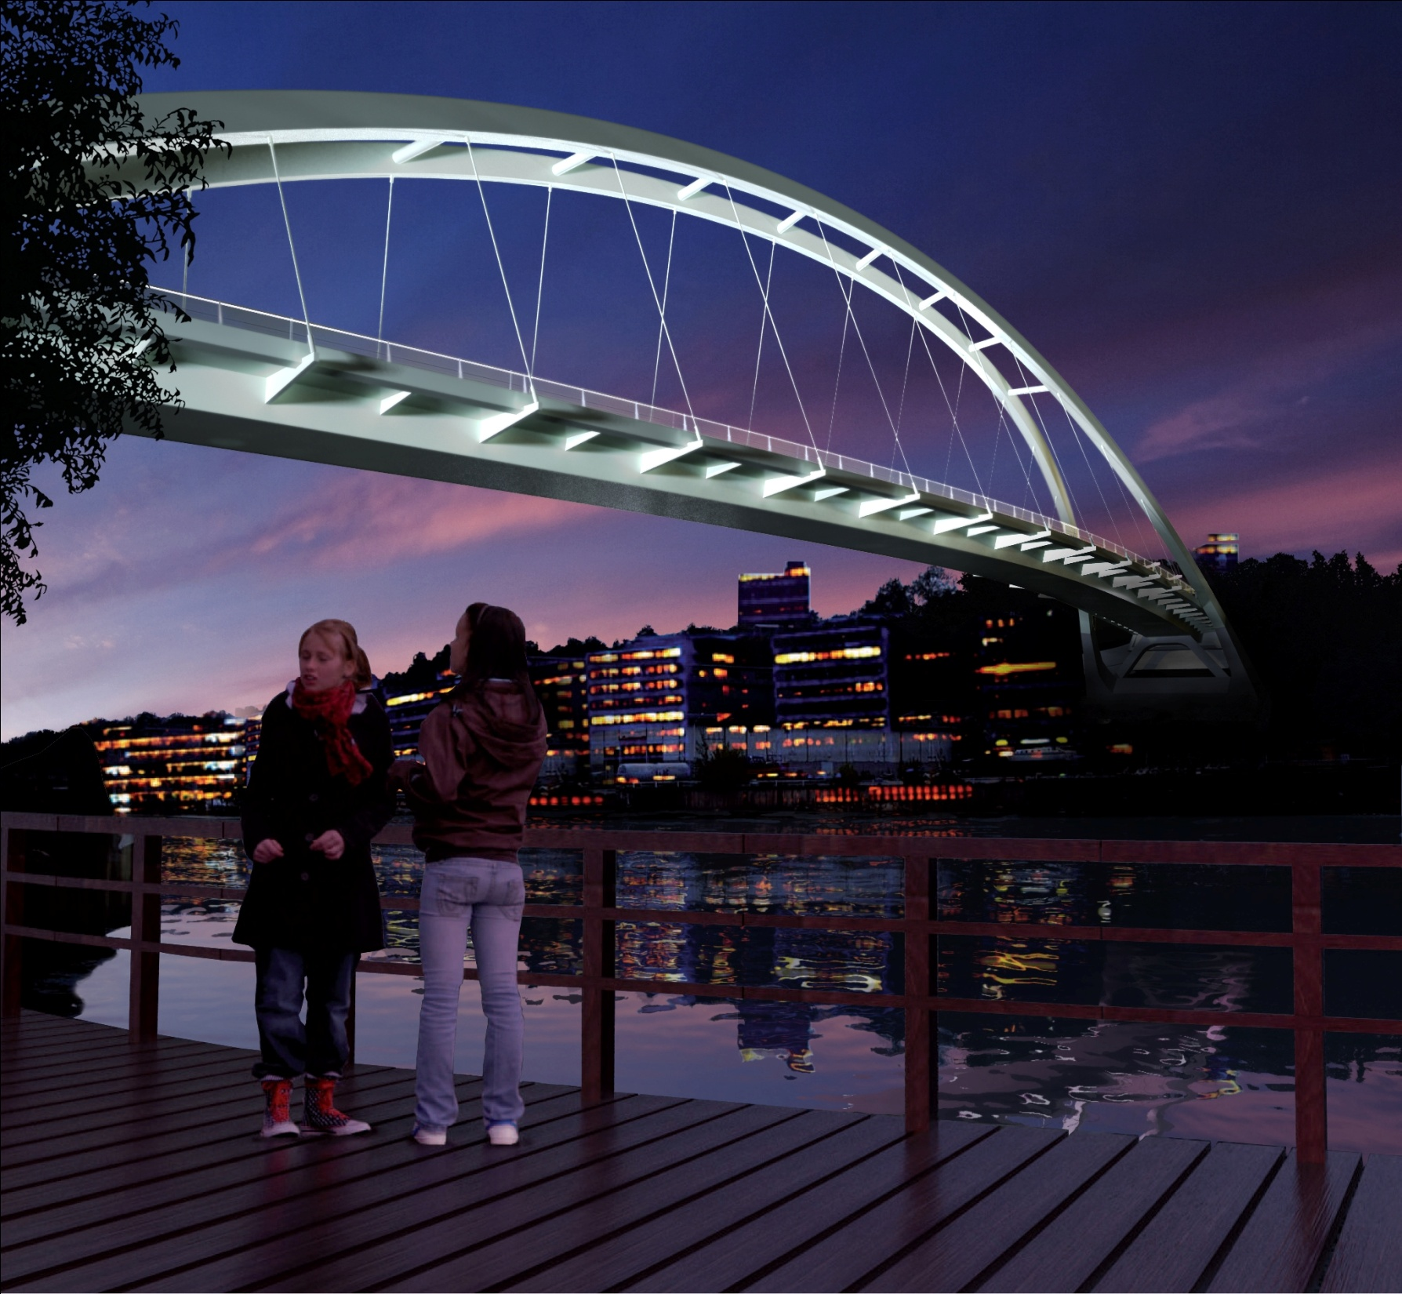
The winner company´s own bridge proposal

Slide 5
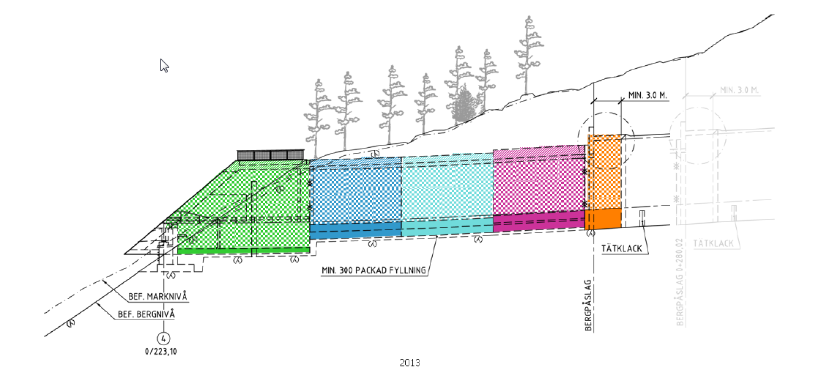
Rock tunnel
2 tenderers had similar solutions
The extension of the rock tunnel and thereby decreasing the length of the concrete tunnel as well as excavation on Ryssbergen.

Slide 6
Tenders compiled
Anbudsgivare | Pris huvud | Alternativ
A | 347.122.096 | 298.574.000
B | 299.980.000 | 263.000.000
C | 304.410.139 | 253.504.424
Contract sum

Slide 7
Evaluation process
Weightning on peer review between 4 criteria
 | Criteria | Weight
a) | Price | 70%
b) | Best bridge as well as tunnel solutions/LCC | 15%
c) | Tenderer organisation | 5%
d) | Enviromental consideration | 10%

